Slide 1

ON BUSD

Slide 2

BREAKING NEWS!
FORSAGE launches on BUSD Binance Smart Chain
The thing is, FORSAGE is facing the problem of too many people wanting to join our community. On the ETH network, the fees are too high. On the TRX network, it's hard to make a transaction because of bugs in that blockchain as well the transaction fees have also gone up. This is why FORSAGE is launching a contract on Binance Smart Chain with BUSD token in the core of the marketing.
We must say that we are not abandoning other blockchains. We believe in Ethereum and Tron, and we will continue to work on these blockchains. But right now is the time to open up to something new.
FORSAGE.IO 2

Slide 3
What is BUSD token and its advantages?
BUSD is a cryptocurrency with a stable exchange rate equal to 1 USD, with the fully audited code and approved by New York State Department of Financial Services.
5 Advantages of FORSAGE on BUSD:
1. Fixed value. All your results in FORSAGE networking are no longer dependent on the price movements and market corrections;
2. Same crypto opportunities. BUSD token can be swapped instantly to any cryptocurrency via DEX swaps at almost zero cost;
3. Simplicity of calculations. Registration costs, upgrades and recycles are denominated in USD;
4. Accurate planning. Precise expense tracking and results estimation without additional rate conversions;
5. Consumer Protection. BUSD is 1:1 fully USD-backed currency, easy to convert value of exchange between USD and BUSD and was launched in partnership with Paxos and Binance.
FORSAGE.IO 3

Slide 4


IMPORTANT!
The BUSD used in the marketing is a BEP-20 format token on the Binance Smart Chain blockchain.
For sending BUSD, or any other token on the BSC network, you must pay a certain amount of BNB for the transaction. So, it is required to have BUSD to participate in the marketing and enough BNB to pay the network fees.
FORSAGE.IO 4

Slide 5

FORSAGE Marketing

Slide 6



DECENTRALIZATION
What does "decentralized" mean? What are the advantages and what are the benefits?
Decentralized marketing is created with an automated contract that offers you maximum security and sustainability. A smart contract is an automatic execution algorithm. It exists within the Binance Smart Chain blockchain, one of the TOP crypto currencies.
Smart contracts, like cryptocurrencies, are decentralized. They work strictly according to the underlying program, without the possibility of subsequently changing the defined execution. The code that contains all the logic of the contract execution is on the blockchain and all calculations are provided by millions of computers around the world. This ensures that there is no risk of hacking into the smart contract and stopping the it.
* The blockchain is an immutable record of transactions and information, which is cryptographically protected from any subsequent manipulation using thousands of independent computers worldwide
FORSAGE.IO 6

Slide 7
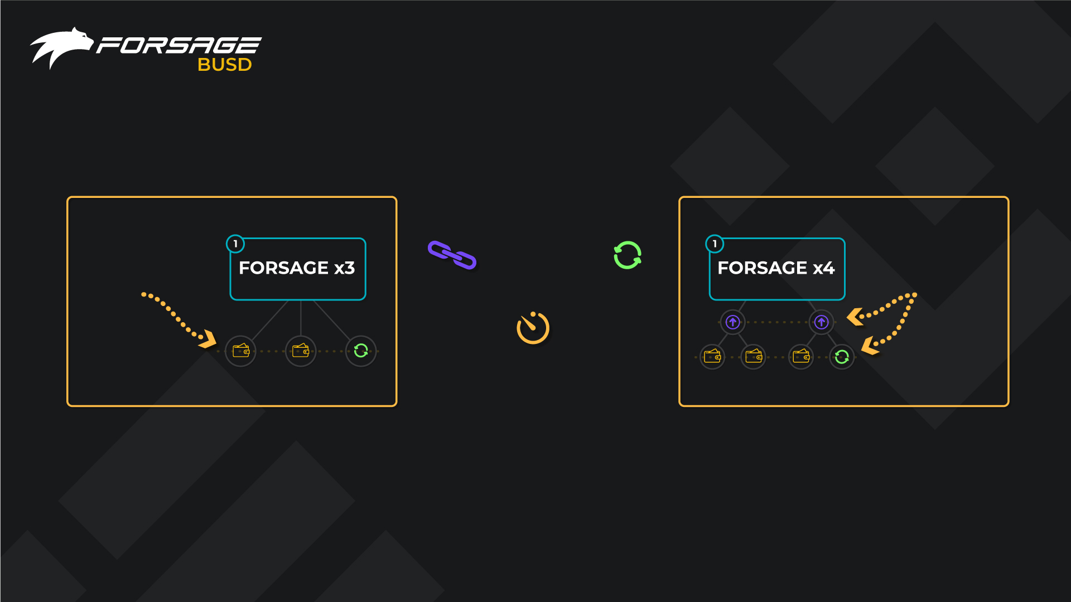
HOW DOES FORSAGE
MATRIX MARKETING WORK?
ONE LINE
3 PLACES
TWO LINES
2 + 4 PLACES
PERMANENT
REFERRAL
BONDING
UNLIMITED
AUTOMATIC
RECYCLES
NO EXPIRATION
DATE OF THE SLOT
FORSAGE MATRIX MARKETING is a fair, economically sound system, without deadlines for slots, with a limited number of places and an unlimited number of recycles.
In the FORSAGE x3 PROGRAM below you is three places in one line. In the FORSAGE x4 PROGRAM below you are two lines – 2 places in the first line and 4 places in the second. When you register in FORSAGE, you open both programs simultaneously.
FORSAGE.IO 7

Slide 8
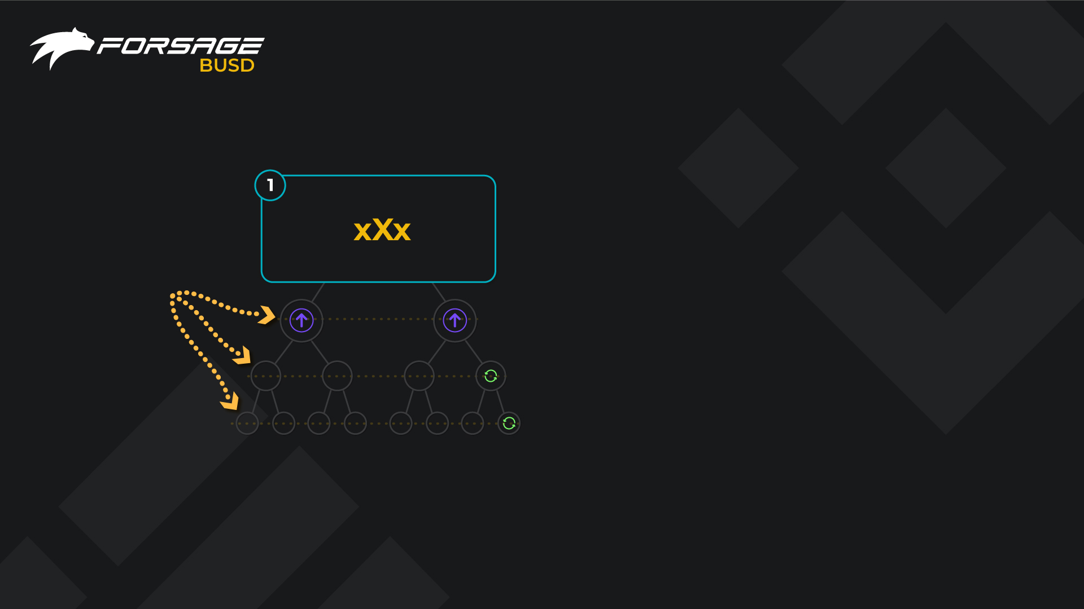
FORSAGE xXx
In the xXx matrix you have 14 places on 3 lines. 2 - in the 1st line, 4 places - in the 2nd line and 8 - in the 3rd
Partners in your matrix may:
- be invited by you directly
- come as spillovers from uplines, up to 2 lines!
- come as spillovers from downlines!
THREE LINE
14 PLACES
FORSAGE.IO 8

Slide 9
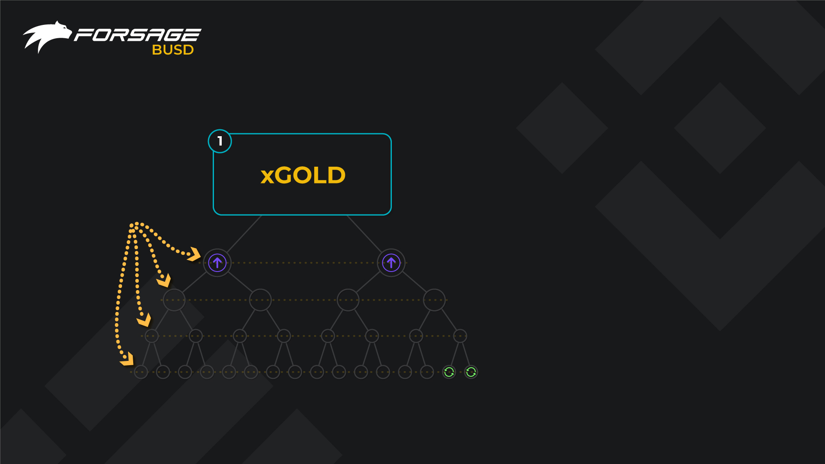
FORSAGE xGold
In the xGold matrix you have 30 places on 4 lines. 2 - in the 1st line, 4 places - in the 2nd line, 8 - in the 3rd and 16 - in the 4th.
Partners in your matrix may:
- be invited by you directly
- come as spillovers from uplines, up to 3 lines!
- come as spillovers from downlines!
FOUR LINE
30 PLACES
FORSAGE.IO 9

Slide 10
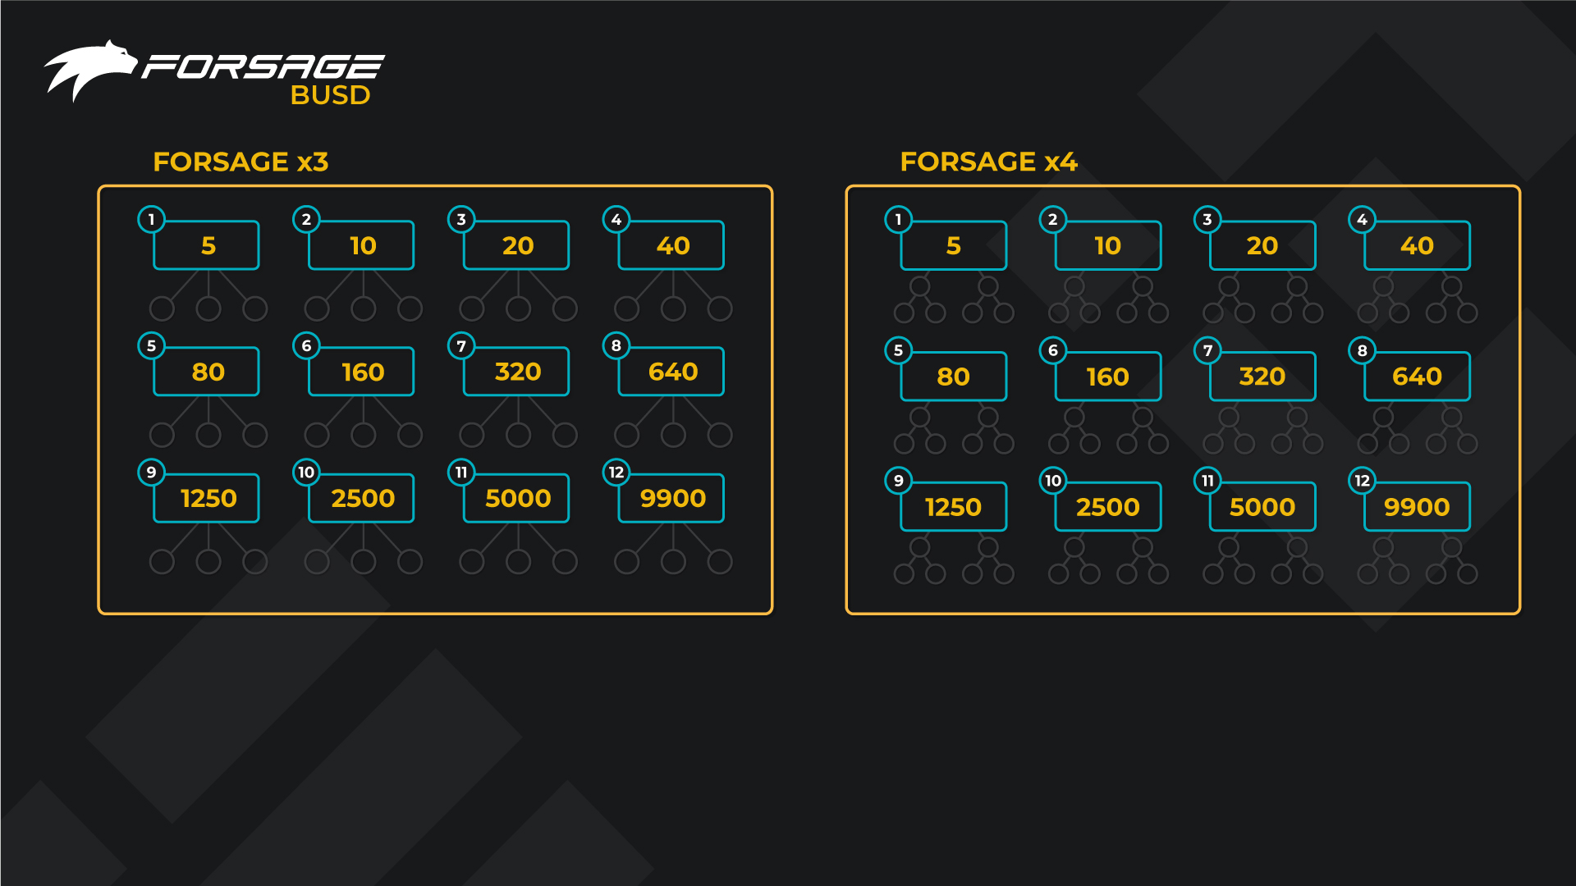
SLOTS x3 AND x4
In each of these two programs, FORSAGE x3 and FORSAGE x4 have 12 slots. All similar and work in the same way. Each subsequent slot is 2 times more expensive than the previous one. Both income and profits from them are twice as high!
How many slots can be activated immediately? As much as you want! At least all twelve at once! They have no expiration date, so you can not be afraid that they will burn. All active slots move and bring you revenue in parallel
FORSAGE.IO 10

Slide 11
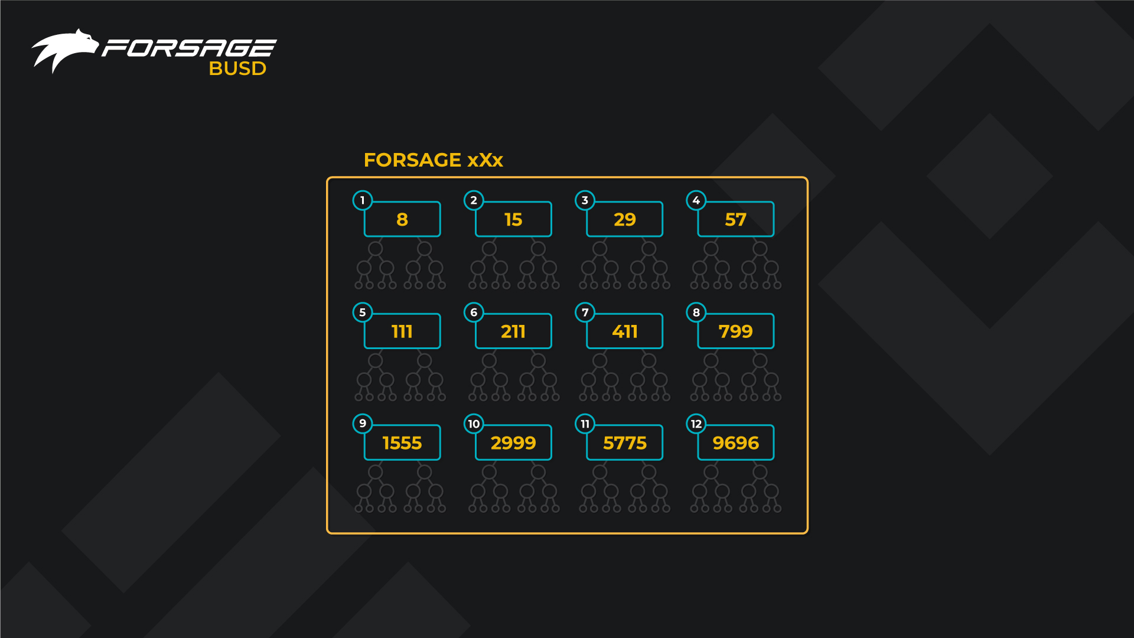
SLOTS xXx
FORSAGE.IO 11

Slide 12
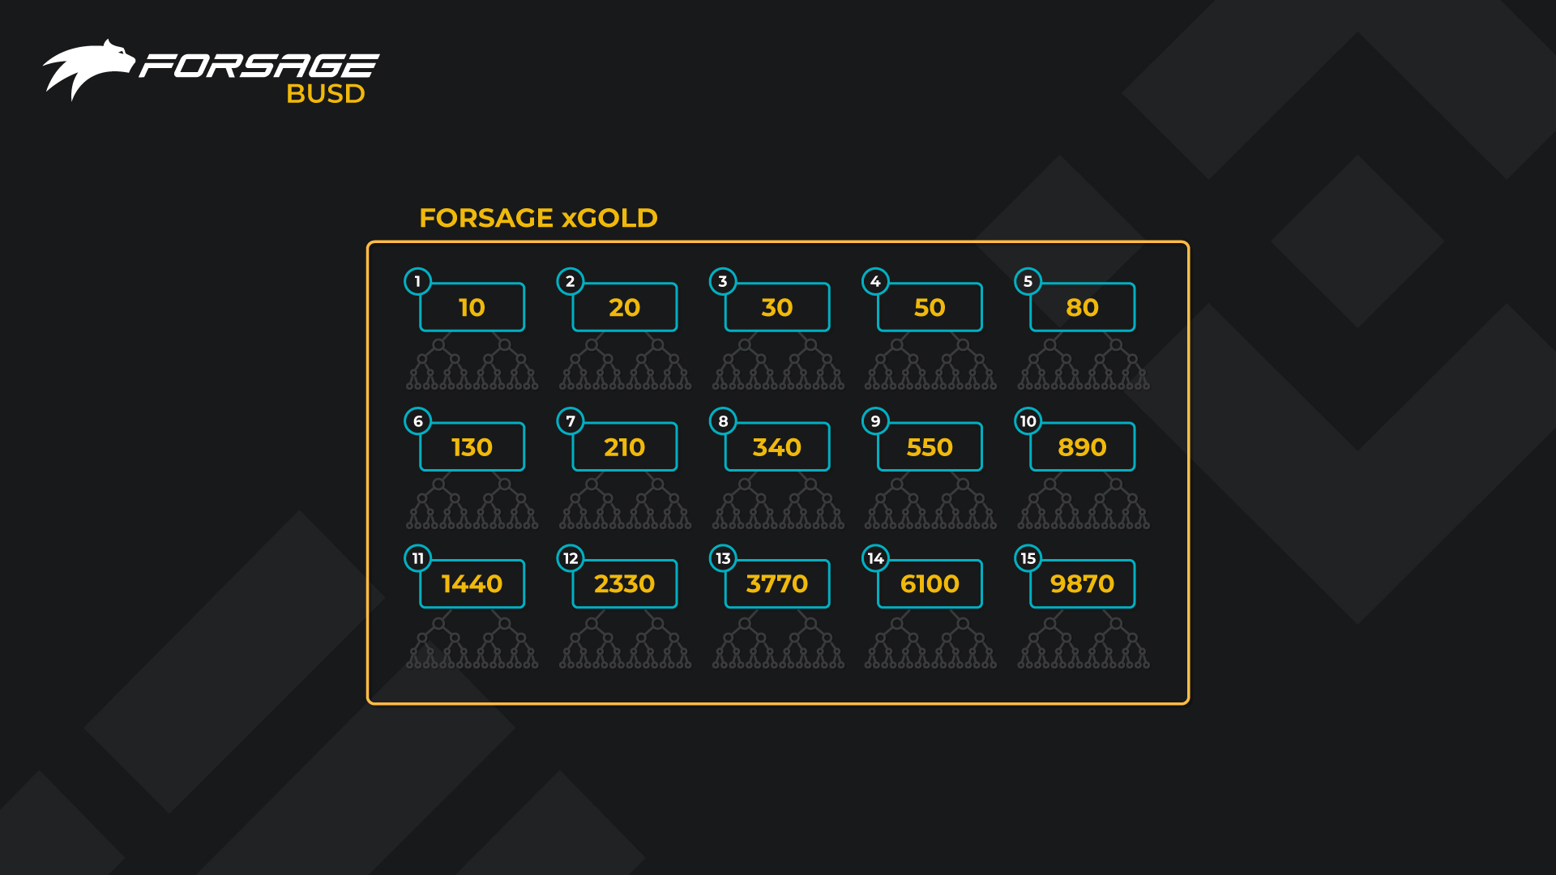
SLOTS xGold
FORSAGE.IO 12

Slide 13
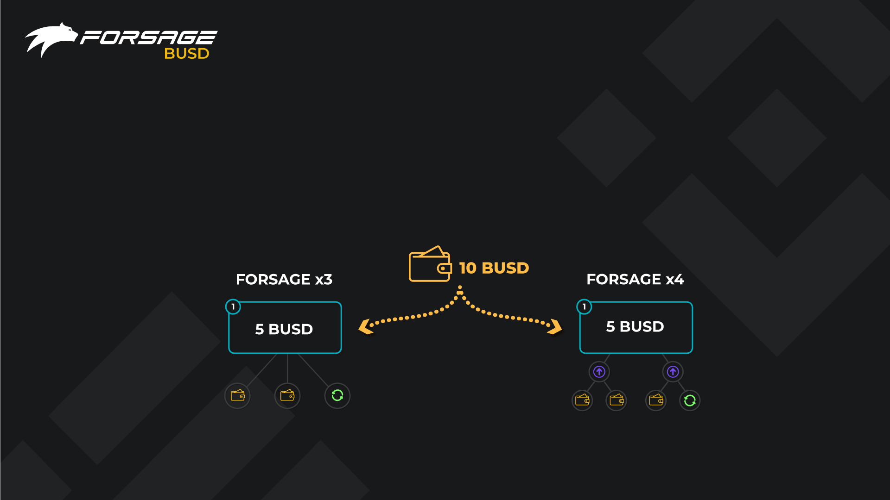
REGISTRATION
To get registered in FORSAGE a new member activates the first slots in x3 & x4 programs, which cost 5 BUSD each. It makes it 10 BUSD in total to register. The first slots of x3 & x4 are always activated together, they cannot be purchased separately. Next slots (Upgrades) can be activated separately but only one after another.
After the launch of x3 & x4 programs on BSC, 2 more programs will be added consequently one at a time (launch schedule to be announced): xXx and xGold. xXx program first slot costs 8 BUSD and can be activated only after at least the first slots in x3 and x4 were activated before. xGold first slot is 10 BUSD and can only be activated after at least 1 slot in xXx was purchased.
FORSAGE.IO 13

Slide 14

FORSAGE x3
All partners in your slots of the FORSAGE x3 PROGRAM are your personally referred partners. When you invite partners, they take places under you. The distribution of payments when filling out the matrix automatically occurs as follows:
The first referral partner takes a place under you.
100% payout goes to your personal wallet
The second referral partner takes second place below you.
Payment is also instantly credited to your personal wallet.
The third partner takes third place below you.
You again receive 100% income, but in the form of RECYCLE.
RECYCLE opens the same slot for you again, and you continue to receive income from it. Recycling the slot, you take next free place in your superior partners’ slot. Accordingly, 100% for recycle is transferred to your superior.
UPLINE
YOU
FORSAGE.IO 14

Slide 15
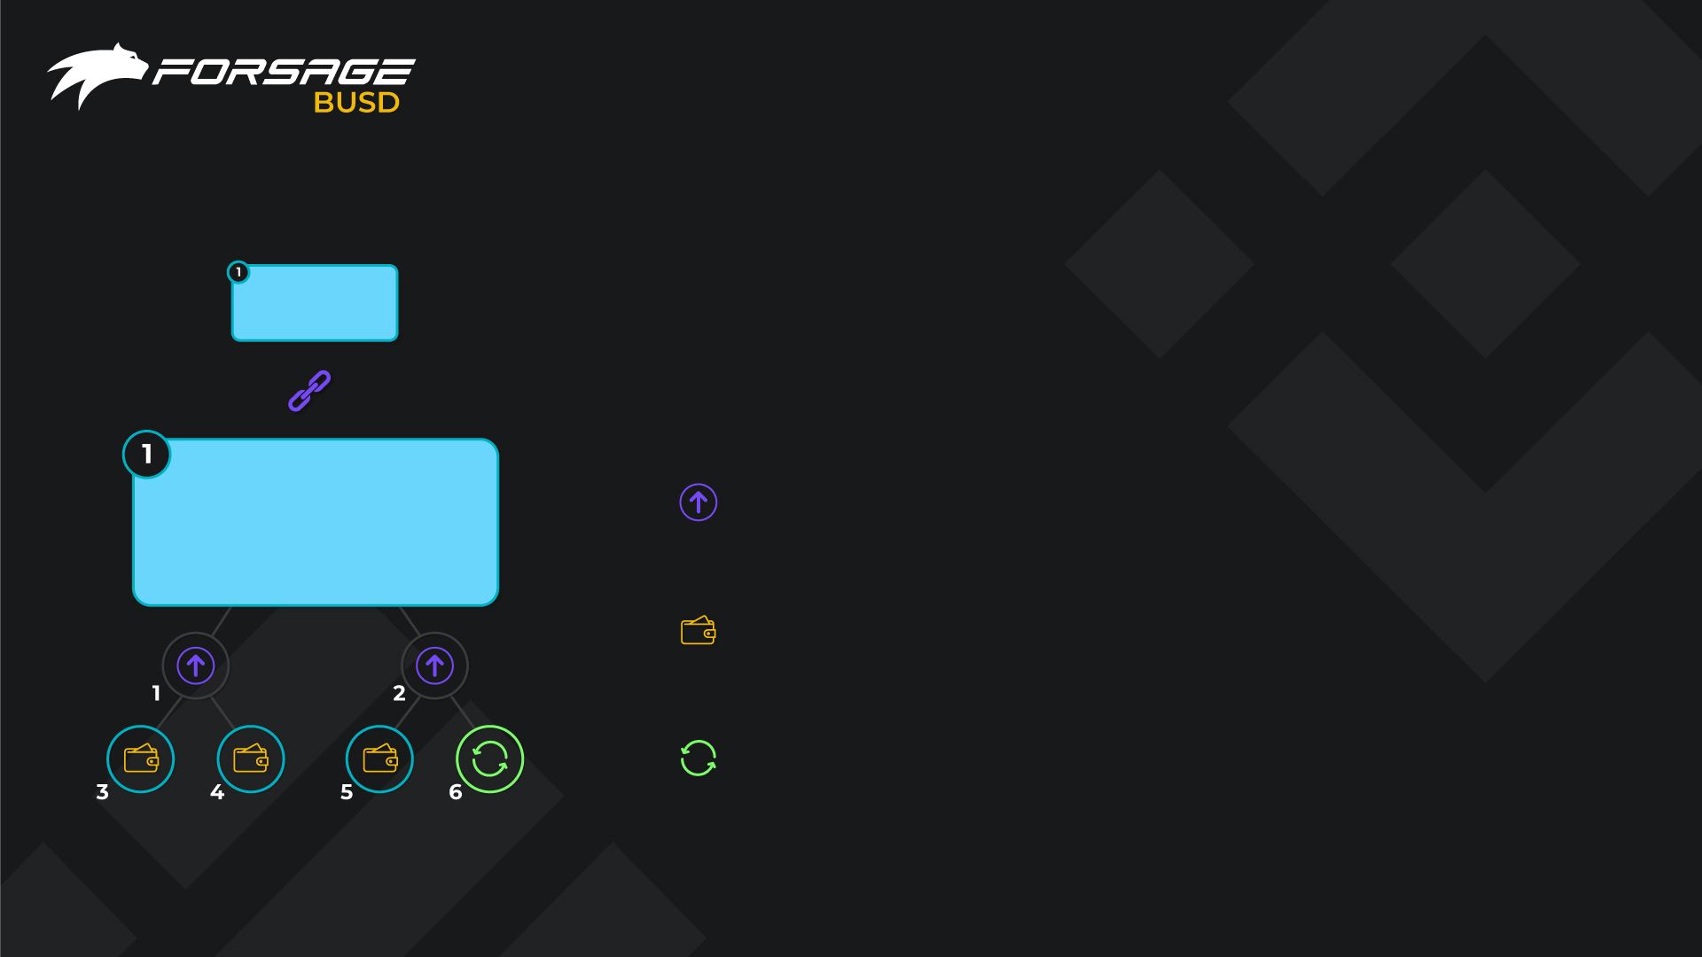
FORSAGE x4
UPLINE
In parallel, the FORSAGE x4 PROGRAM also works for you, here an overflow system is organized from above and from below. We are building a team together. There may be at least all of you invited, at least not one invited by you, or mixed.
Partners who take two places below you in the first line are two places in the second line of the higher. A 100% payment goes to the wallet of your higher partner.
You also receive income from the second line, 100% from four people. Of these, 3 payments go instantly to your wallet.
The last payout is the closing slot, and it also makes a recycle, buying you the same slot again, and the payment of 100% is transferred to your higher partner.
YOU
YOU
FORSAGE.IO 15

Slide 16
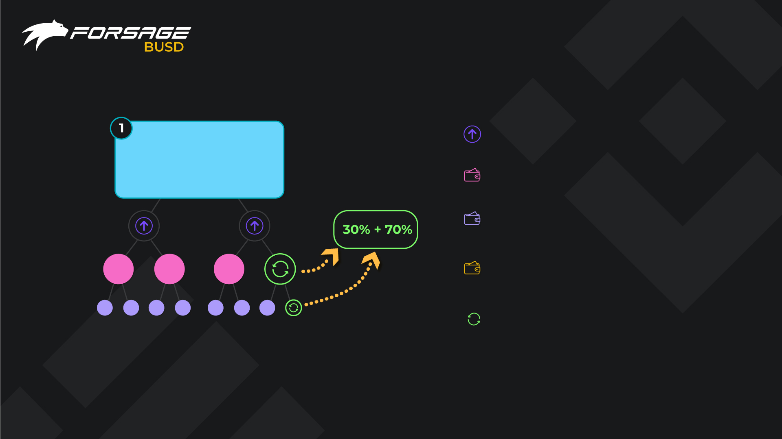
FORSAGE xXx
Payments of 2 people in the 1st line go to your upline (the same as in x4).
On the 2nd line, you get 30% from each of 4 places, and 70% goes to your upline
And on the 3rd line, you get 70% from 8 places while 30% goes higher in the structure
Thus, the total yield is 580% from one cycle of the slot, 100% of which is used for automatic recycle
So, two last payments from each line: one from the 2nd line (30%) and one from the 3rd line (70%), are summed up and used to recycle the slot.
YOU
FORSAGE.IO 16

Slide 17
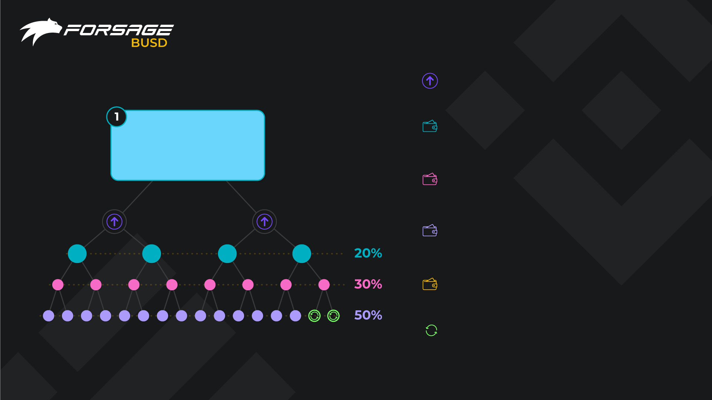
FORSAGE xXx
Payments of 2 people in the 1st line go to your upline (the same as in x4)
On the 2nd line, you get 20% from each of the 4 places. The rest 80% is split into 30% and 50% and sent to your uplines
On the 3rd line, you get 30% from each of 8 places while the rest 70% is split into 20% and 50% and go to uplines
And on the 4th line, you get 50% from 16 places. While the rest 50% is also divided into 20% and 30% to go to your uplines
Thus, the total yield is 1120% from one circle of the matrix, 100% of which is used for automatic recycle of the slot
So, last 2 payments from 4 line, 50+50%, are used for recycle
YOU
YOU
FORSAGE.IO 17

Slide 18
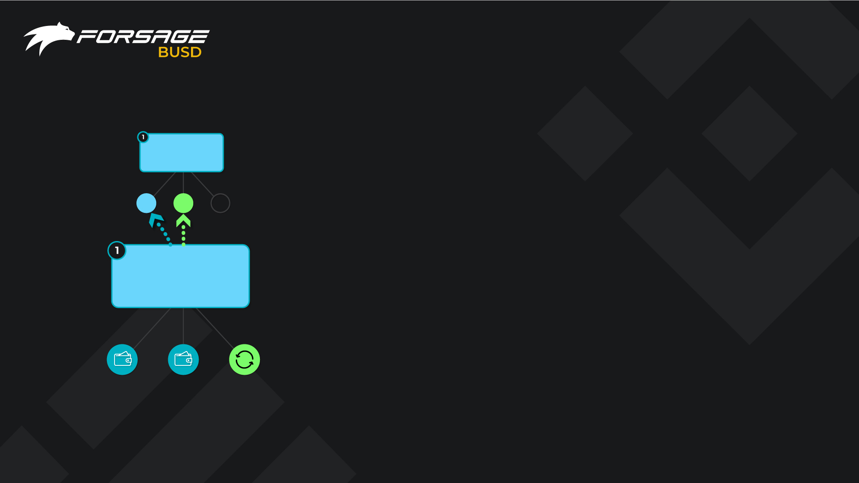
RECYCLE
RECYCLE – this is the re-cycling (re-purchase) of the slot at the
current level.
Recycle opens the same slot for you again, and you continue to
receive income from it. Without a recycle, a slot would close, and
stop.
Recycle is done automatically, as soon as the last free place is taken by a partner, the current slot closes and goes to the archive.
You re-occupy the free space in the slot of a higher partner and
a new slot of the same level with free places opens for you, and 100% payment goes to the wallet of your higher partner.
Similarly, your referral partners will have recycles, and you will
instantly receive income every time.
UPLINE
YOU
YOU
YOU
FORSAGE.IO 18

Slide 19
xXx RECYCLE: YOUR
INDIVIDUAL SMART CONTRACT
How automatic recycle in xXx works?
The secret is - in... your own smart contract!
For a new activation of same slot, 100% amount of its value is required. But payments from 3rd line are 70% each, so you need to collect 30% more to recycle.
It is impossible to know exactly in advance in what position the partner should stand inside the matrix, so you cannot take a place in advance.
It is also unacceptable for us to create a common fund accumulation in the smart contract of the Community.
We always emphasize that we do not collect participants' funds on the Forsage smart contract balance!
But we need an automatic recycle! Otherwise, situations will constantly arise when you do not have time to pay recycle in time, your partners can get ahead of you. And this is unfair, because it is impossible to monitor the right moment around the clock. Your matrix may get filled, for example, while you sleep.
In Forsage, you have your own smart contract on the BSC, which is not available to anyone but you!
The first payment of 30% goes to your individual contract from the last partner on the 2nd line, and another 70% will be added from the last partner on the 3rd line of the matrix to recycle it automatically.
The 1st payment of 30% is only accessible to you and is locked until the 2nd payment of 70% arrives.
Then everything goes in a circle. And your partners, in the same way, closing their matrices again rise to you in a new matrix.
FORSAGE.IO 19

Slide 20
xGold RECYCLE: YOUR
INDIVIDUAL SMART CONTRACT
Automatic recycle in xGold works based on individual contract as well:
For a new activation of same slot, you need amount of 100% of its value.
But payments from 4 lines are 50% each, so you need to collect 2 payments.
It is impossible to know exactly in advance in what position the partner should stand inside the matrix, so you cannot take a place in advance.
It is also unacceptable for us to create a fund accumulation in the smart contract of the Community.
We always emphasize that we do not collect participants' funds on the Forsage smart contract balance!
But we need an automatic recycle! Otherwise, situations will constantly arise when you do not have time to pay recycle in time, your partners can get ahead of you. And this is unfair, because it is impossible to monitor the right moment around the clock. Your matrix may close, for example, while you sleep.
But in Forsage, you have your own smart contract on the BSC, which is not available to anyone but you!
The penultimate payment of 50% goes to you individual contract, and only you can manage these funds.
As soon as the last matrix payout comes, it is summed up with the penultimate one, and the new same matrix is automatically activated.
Then everything goes in a circle. And your partners, in the same way, closing their matrices again rise to you in a new matrix.
FORSAGE.IO 20

Slide 21
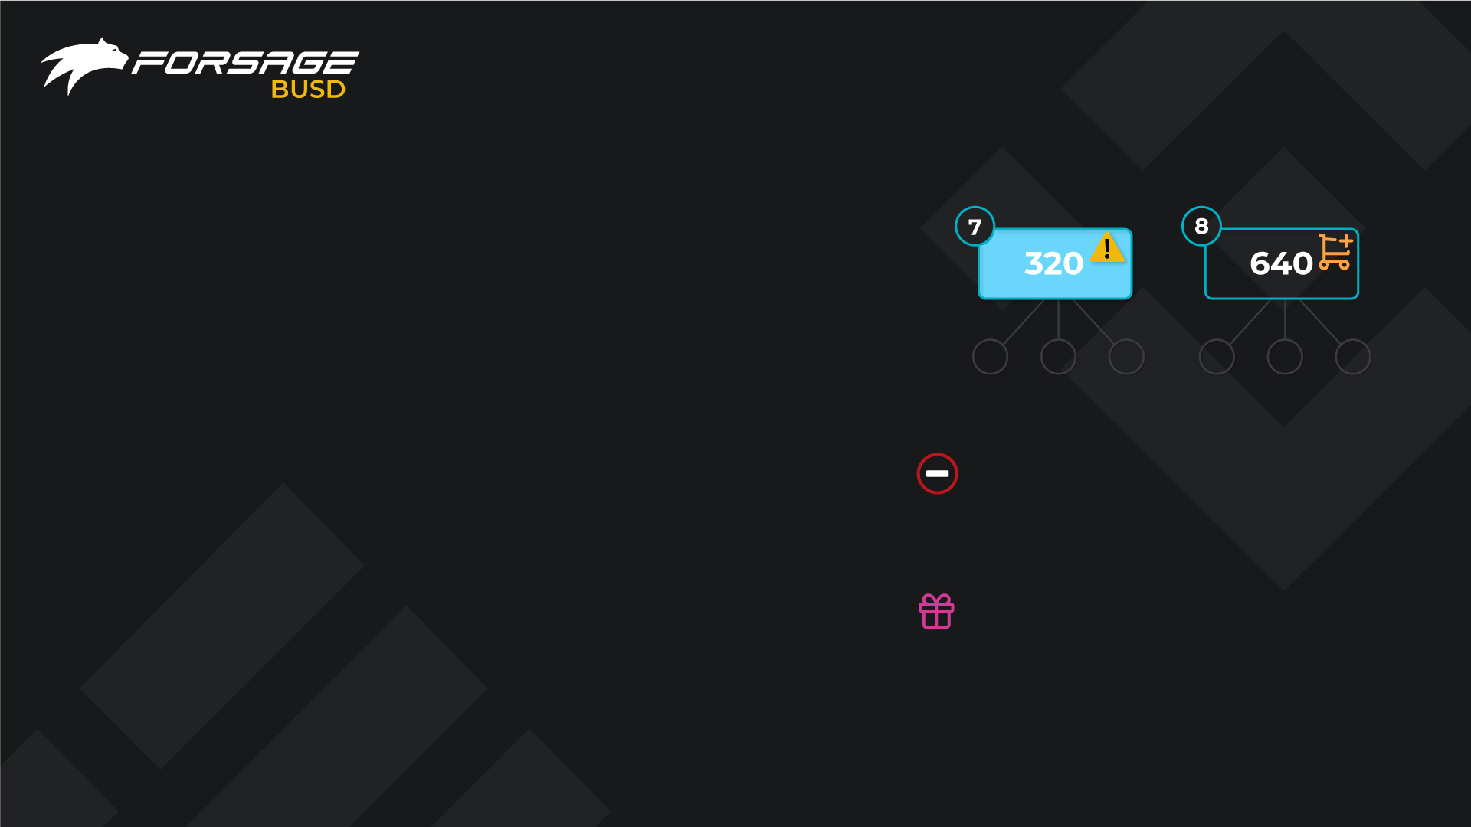
UPGRADE
UPGRADE – is the opening (purchase) of the next slot of a more expensive level. It is done once at the first opening of the slot. The payment goes to your superior partner, provided that he has a slot of this level.
There is enough income from each slot to recycle the slot of the same level and buy a slot of the next level.
You decide whether to purchase the next level slot!
A recycle of the slot occurs automatically. If the next slot is not open for you, then from the second round, after recycle, all payments will be redirected to a higher partner.
When you buy the necessary slot, then at the next recycle your referral partner will take a place under you, and with each recycle will take a place under you again.
Missed profit – payment sent to a higher partner, due to the lack of an upgrade to a more expensive slot
Extra profit – payment received to you
at the expense of the Missed profit of a
lower partner
FORSAGE.IO 21

Slide 22
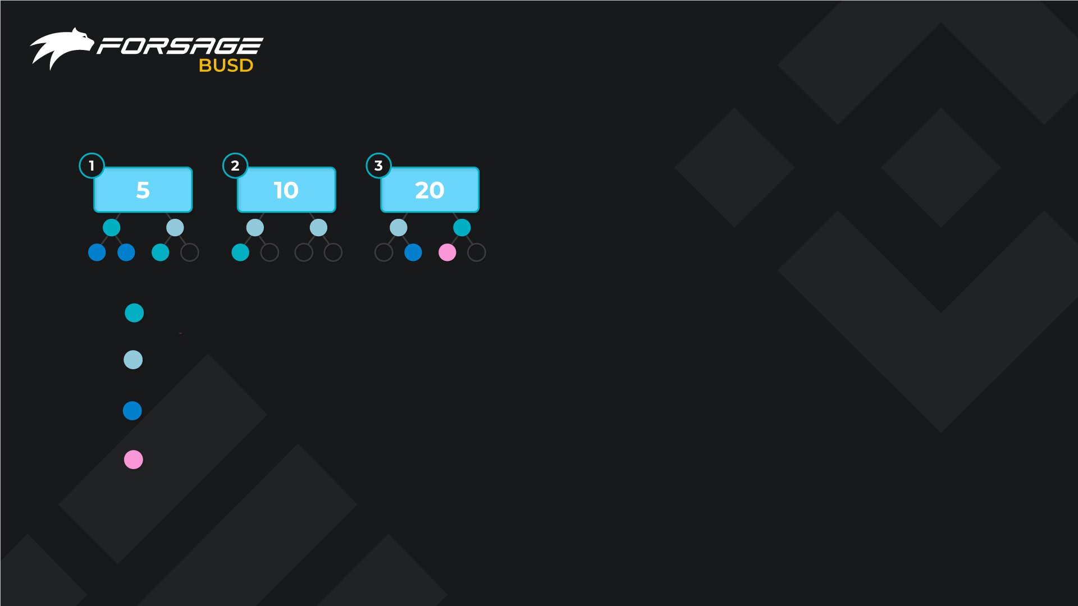
OVERFLOWS, OVERTAKING
AND RETURNS
You can overtake your superior partner by opening slots which he has not yet reached.
In this case, you get up to his superior partner, the closest who has such level of the slot, and the income goes to him.
If he doesn’t have this slot available, then in the same way you are already overtaking two superiors until the system finds a partner who already has active slot of this lievel.
Referral link returns the partners. This means that when your superior buys this slot, then the next recycle, you will again take a place under him.
personal partner
overflow (personally invited partner of your superior)
overflow from below (personally invited partner of your downline)
partner who overtook his superior
FORSAGE.IO 22

Slide 23
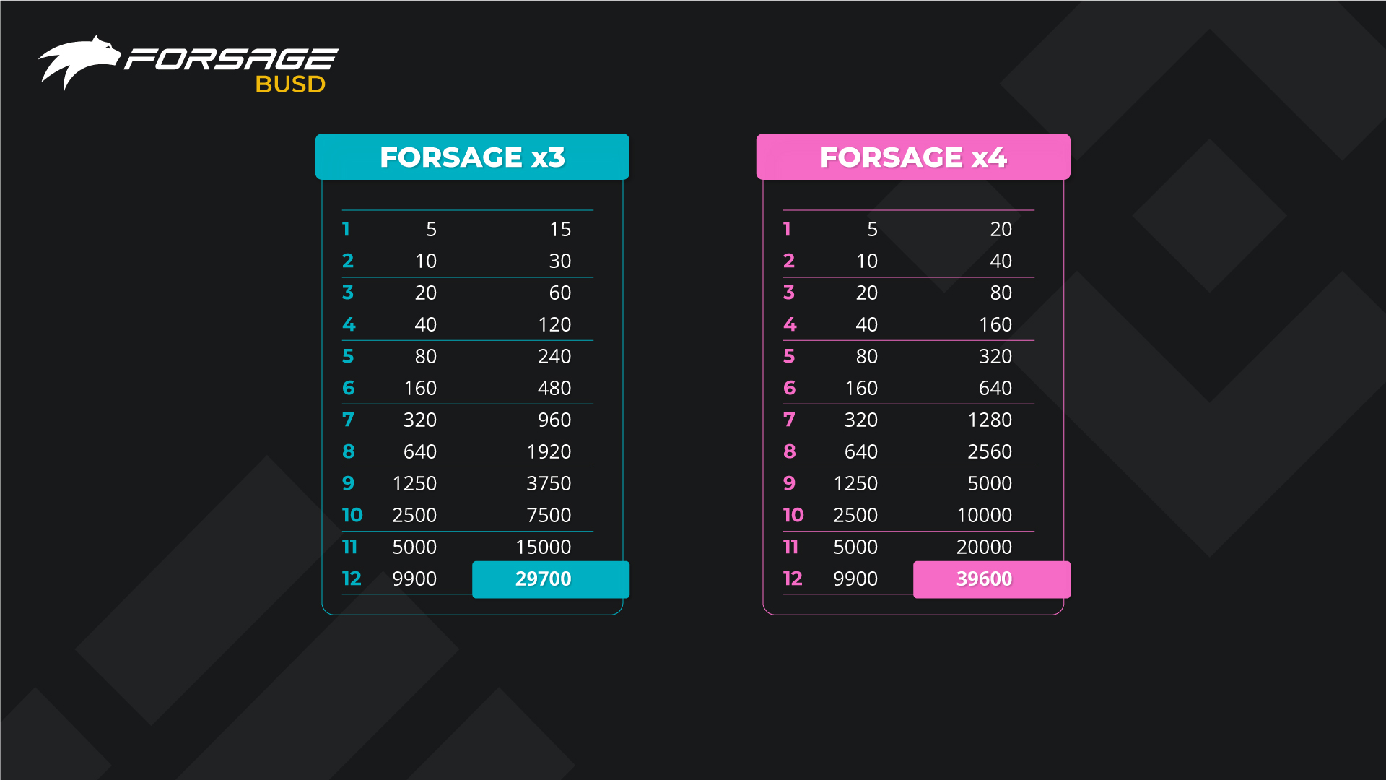
PROFIT
1 cycle income, BUSD Price, BUSD
1 cycle income, BUSD Price, BUSD
* BUSD is a stable coin, BUSD/USD rate = 1
* BUSD is a stable coin, BUSD/USD rate = 1
FORSAGE.IO 23

Slide 24
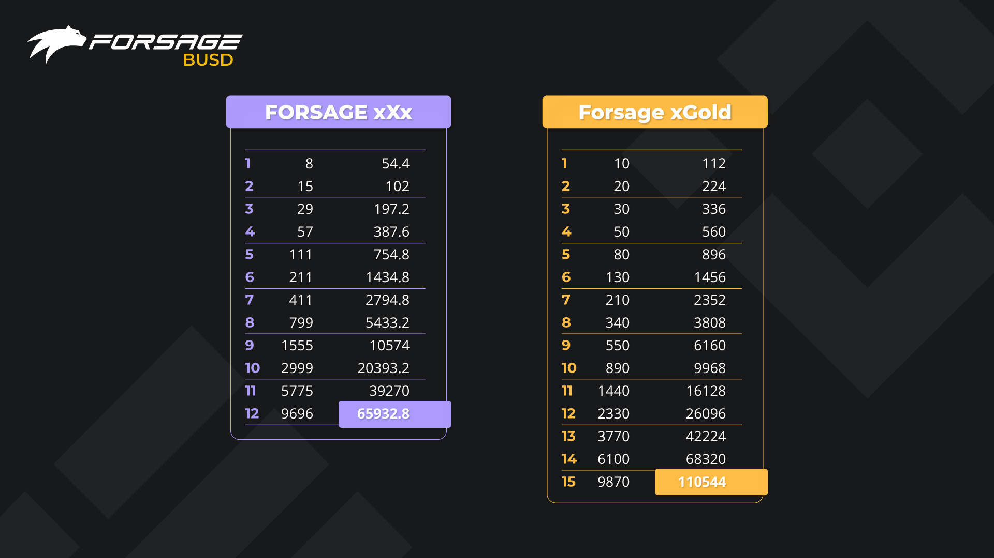
PROFIT
1 cycle income, BUSD Price, BUSD
1 cycle income, BUSD Price, BUSD
* BUSD is a stable coin, BUSD/USD rate = 1
* BUSD is a stable coin, BUSD/USD rate = 1
FORSAGE.IO 24

Slide 25
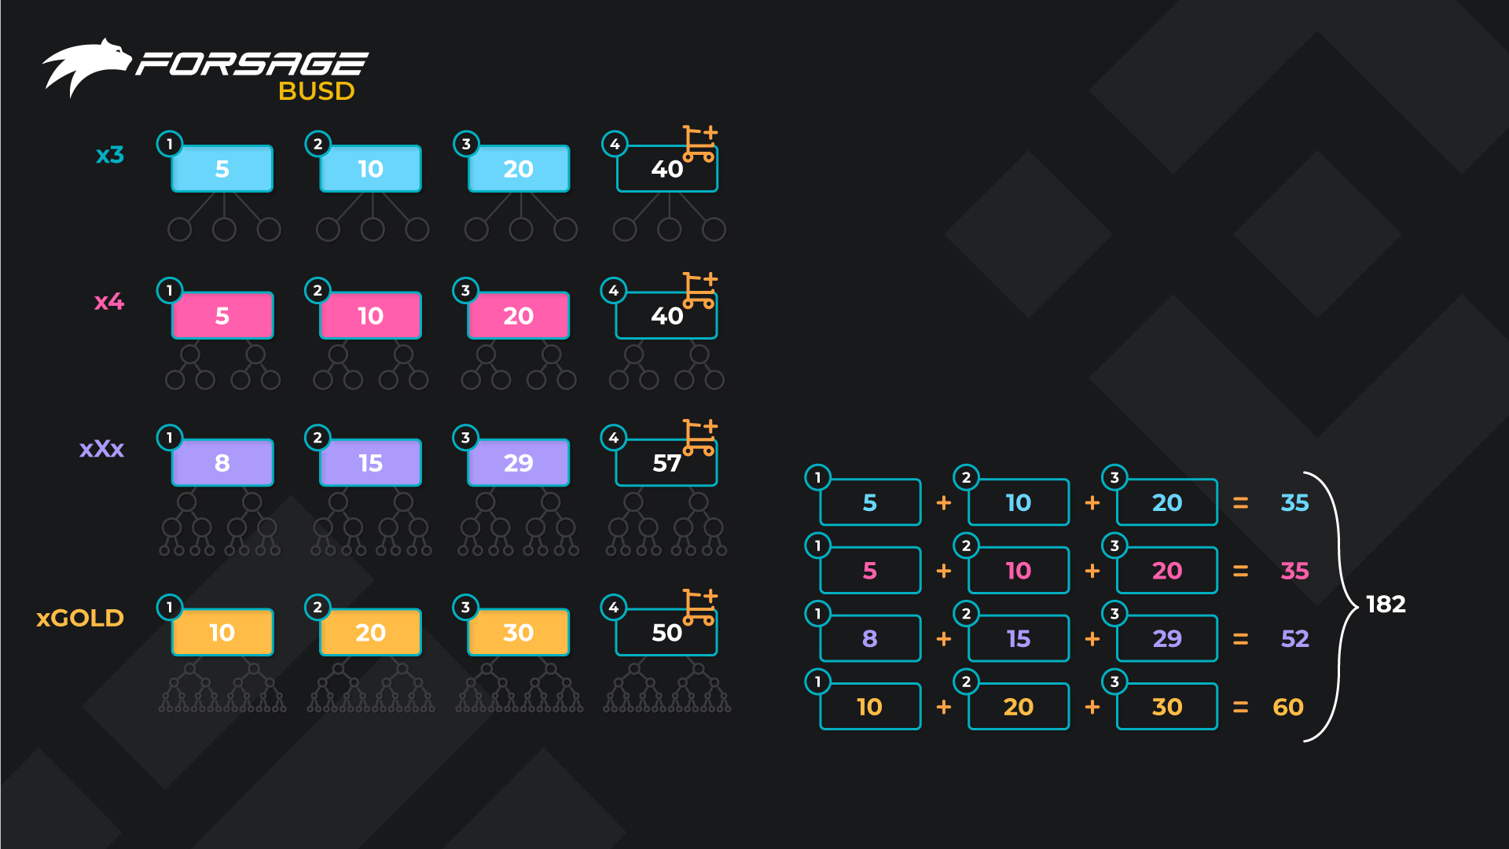
MINIMMUM RECOMENDED START OPTION
It is recommended to activate minimum first three slots at the start. This ensures good initial results.
Of course, you can only start with only first slot. However, just starting with a slot could quickly lead to overflows if your structure develops quickly.
The most successful partners use strategies for starting from several slots at once. They set such an example themselves and the partners do the same. As a result, their turnovers grow faster.
Many start from 5 slots at once, some even from 7 slots or more.
FORSAGE.IO 25

Slide 26
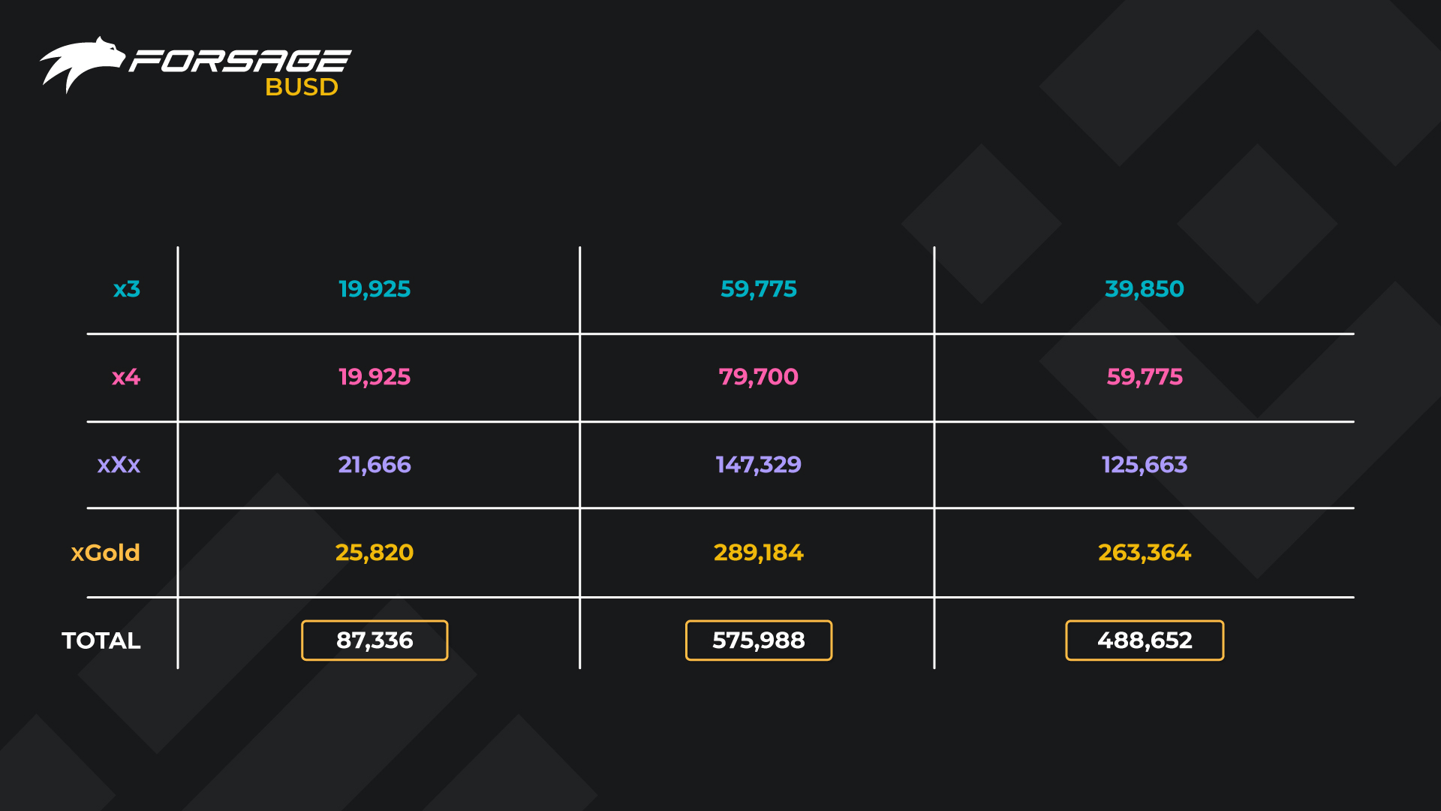
PROFITS FROM FORSAGE WHEN ALL SLOTS
PURCHASED AND ALL SLOTS RECYCLE
TOTAL SLOTS COST, BUSD
1 CYCLE INCOME, BUSD
NET PROFIT FOR 1 CYCLE, BUSD
* Based on the rate BUSD/USD = 1
FORSAGE.IO 26

Slide 27
Frequently Asked Questions

Slide 28
Why Binance Smart Chain?
There are many promising networks, but not all of them are popular enough or well developed. Binance Smart Chain was chosen because of several reasons:
- excellent bandwidth;
- low fees;
- well developed infrastructure;
- growing popularity;
- an impeccable reputation.
FORSAGE.IO 28

Slide 29
What about other blockchains?
Ethereum and Tron are not going anywhere. We will continue to support these blockchains. We are sure that sooner or later, the Ethereum network will solve the fee issue, and the Tron network will fix all the bugs. Their developers are working on it.
But the FORSAGE Community should not stand by and wait for that moment to come. We must act so that our joint endeavor can grow. This means that we will use other suitable networks if they suit our users.
FORSAGE.IO 29

Slide 30
Will there be new programs with BUSD?
Each of the three blockchains will run the same programs - x3, x4, and xGold. In terms of structure and cost, the introduction of the third blockchain does not change our users’ experience and FORSAGE idea in any way.
But we decided that a new matrix should be launched on Binance Smart Chain. The new matrix called xXx will become a kind of exclusive that will attract new users to the blockchain. Over time, all the 4 programs will be available on all the blockchains.
How to prepare for the launch of FORSAGE Binance Smart Chain?
We recommend preparing in advance before the launch because we are sure it will be hot! It's wise to prepare the amount of BUSD and some BNB for the fees needed to open the right number of slots and make sure you set up a BSC-supporting wallet with BEP20 token format support. Make sure BUSD and BNB are in BEP20 format.
FORSAGE.IO 30

Slide 31
And here are some links to help you:
FORSAGE founder Lado Okhotnikov talks about FORSAGE launch on Binance Smart Chain (~7 minutes) https://youtu.be/1Pus7sXFEMI
Buy BNB or BUSD on Binance https://www.binance.com/en/buy-sell-crypto
Buy BNB or BUSD directly from Trust Wallet https://trustwallet.com/buy-bnb/
Swap BNB to BUSD instantly via Pancake Swap https://exchange.pancakeswap.finance/#/swap
Learn more about Binance Smart Chain https://www.binance.org/en/smartChain
Binance Smart Chain gas price chart https://bscscan.com/chart/gasprice
Binance Smart Chain Explorer -
here you can find and track all blockchain transactions https://bscscan.com/
Recommended wallets:
Metamask https://metamask.io/ (desktop browser extension and mobile app)
Binance Smart Chain Wallet (desktop browser extension only) https://chrome.google.com/webstore/detail/binance-chain-wallet/fhbohimaelbohpjbbldcngcnapndodjp
TrustWallet https://trustwallet.com/ (mobile app only)
Tokenpocket https://www.tokenpocket.pro/ (mobile app only)
FORSAGE.IO 31

Slide 32

TIME TO TURN ON THE FORCING

